Slide 1
Smart Factory – Transforming Human Potential into Business Reality
Notes:
This presentation was automatically generated by PowerPoint Copilot based on content found in this document:
https://b2iventures365-my.sharepoint.com/personal/drichards_smartfactory_io/_layouts/15/Doc.aspx?sourcedoc=%7B1D3B2611-9B8E-4112-8C5E-6D18B40714ED%7D&file=Transforming%20Human%20Potenatil.docx&action=default&mobileredirect=true&DefaultItemOpen=1

Slide 2
Agenda
Introduction
Specialization in Innovation
Growth through Intelligence and Action
Specialization in Innovation (Continued)
Smart Team Members
  Smart Engineers™
  Smart Architects™
Unique Factory Approach
Conclusion
Notes:
Agenda
* Introduction
* Specialization in Innovation
* Growth through Intelligence and Action
* Specialization in Innovation (Continued)
* Smart Team Members
* Smart Engineers™
* Smart Architects™
* Unique Factory Approach
* Conclusion

Slide 3

Introduction
Successful Projects Since 2017
  Over $1 billion in successful projects
  Focus on Enterprise and Mid-Size companies
Unique Factory-Based Approach
  Innovative problem-solving methods
  Enhancing business reality through human potential
Notes:
Since 2017, our Smart Factory has achieved over $5 billion in successful projects for Enterprise and Mid-Size companies. We leverage a unique factory-based approach to transform human potential into business reality.
Original Content:
Smart Factory – transforming human potential into business reality
Since 2017, our track record includes over $5 billion in successful projects for Enterprise and Mid-Size companies, leveraging our unique factory-based approach to problem-solving.

Slide 4

Specialization in Innovation
Enterprise Operations
  Implementation
  Environment
  Architecture
  Digital Transformation
Quality Assurance
  Process Optimization
Strategic Technology Planning
M&A Technical Due Diligence
  Over $2 billion in successful transactions
Notes:
This presentation covers advanced AI implementation for enterprises, including operations, quality assurance, strategic planning, and M&A technical due diligence with over $2 billion in successful transactions.
Original Content:
Advanced AI Implementation for Mid-Size and Enterprise
Enterprise Operations, Implementation, Environment, Architecture & Digital Transformation
Quality Assurance & Process Optimization
Strategic Technology Planning
M&A Technical Due Diligence with over $2 billion in successful transactions

Slide 5

Growth through Intelligence and Action
Track Record of Success
  Over $1 billion in successful projects
  Experience with Enterprise and Mid-Size companies
Unique Factory-Based Approach
  Effective problem-solving methodology
Accelerated Growth
  Providing intelligence and action
  Adding the right people to your team
Notes:
We have a proven track record with over $5 billion in successful projects for Enterprise and Mid-Size companies. Our unique factory-based approach ensures effective problem-solving. We provide intelligence and action to accelerate growth by adding the right people to your team.
Original Content:
Our track record includes over $5 billion in successful projects for Enterprise and Mid-Size companies, leveraging our unique factory-based approach to problem-solving.
We provide intelligence and action to produce massively accelerated growth by adding the right people to your team:

Slide 6
Specialization in Innovation (Continued)
Enterprise Operations and Implementation
  Focus on environment, architecture, and digital transformation
Quality Assurance and Process Optimization
  Ensuring high standards and efficiency
Strategic Technology Planning
  Modernizing legacy systems and processes
M&A Technical Due Diligence
  Over $2 billion in successful transactions
Notes:
This presentation covers advanced AI implementation for enterprises, focusing on operations, quality assurance, strategic planning, and M&A due diligence. Key areas include digital transformation and modernizing legacy systems.
Original Content:
Advanced AI Implementation for Mid-Size and Enterprise
Enterprise Operations, Implementation, Environment, Architecture & Digital Transformation
Quality Assurance & Process Optimization
Strategic Technology Planning
Modernizing legacy systems and processes
M&A Technical Due Diligence with over $2 billion in successful transactions

Slide 7
Smart Team Members
Smart Architects™
  Elite, fractional C-suite leaders
  Expertise in technology, operations, and digital transformation
  Deliver architecture and leadership without full-time executive costs
Smart Engineers™
  Multi-disciplinary experts with deep domain knowledge
  Cross-functional capabilities
  Excel in integration, implementation, software development, data science, and systems integration
Smart Assurance™
  AI-enhanced testing methodologies
  ISO standards for quality assurance
  Superior results in testing automation and process optimization
Notes:
We offer accelerated growth by adding the right people to your team. Our Smart Architects™ provide elite leadership without full-time costs. Smart Engineers™ excel in various domains, and Smart Assurance™ ensures superior quality through AI-enhanced testing.
Original Content:
We provide intelligence and action to produce massively accelerated growth by adding the right people to your team:
Smart Architects™
· Elite, fractional C-suite leaders providing expertise in technology, operations, and digital transformation, delivering architecture and leadership without full-time executive costs.
Smart Engineers™
· Multi-disciplinary experts who combine deep domain knowledge with cross-functional capabilities. These AI-empowered professionals excel in integration, implementation, software development, data science, and systems integration.
Smart Assurance™
· The Assurance team leverages AI-enhanced testing methodologies and ISO standards to deliver superior results in quality assurance, testing automation, and process optimization.

Slide 8

Smart Engineers™
Multi-disciplinary Experts
  Combine deep domain knowledge with cross-functional capabilities
  Excel in various fields including integration, implementation, and software development
AI-empowered Professionals
  Specialize in data science and systems integration
Notes:
Smart Engineers™ are multi-disciplinary experts with deep domain knowledge and cross-functional capabilities. They excel in integration, implementation, software development, data science, and systems integration, empowered by AI.
Original Content:
Smart Engineers™
· Multi-disciplinary experts who combine deep domain knowledge with cross-functional capabilities. These AI-empowered professionals excel in integration, implementation, software development, data science, and systems integration.

Slide 9
Smart Architects™
Smart Architects™
  Elite, fractional C-suite leaders
  Expertise in technology, operations, and digital transformation
  Delivering architecture and leadership
  Cost-effective without full-time executive expenses
Smart Assurance™
  AI-enhanced testing methodologies
  Adherence to ISO standards
  Superior results in quality assurance
  Focus on testing automation and process optimization
Notes:
Smart Architects™ offers elite, fractional C-suite leaders with expertise in technology and operations. Smart Assurance™ uses AI-enhanced testing and ISO standards for quality assurance and process optimization.
Original Content:
Smart Architects™
· Elite, fractional C-suite leaders providing expertise in technology, operations, and digital transformation, delivering architecture and leadership without full-time executive costs.
Smart Assurance™
· The Assurance team leverages AI-enhanced testing methodologies and ISO standards to deliver superior results in quality assurance, testing automation, and process optimization.

Slide 10
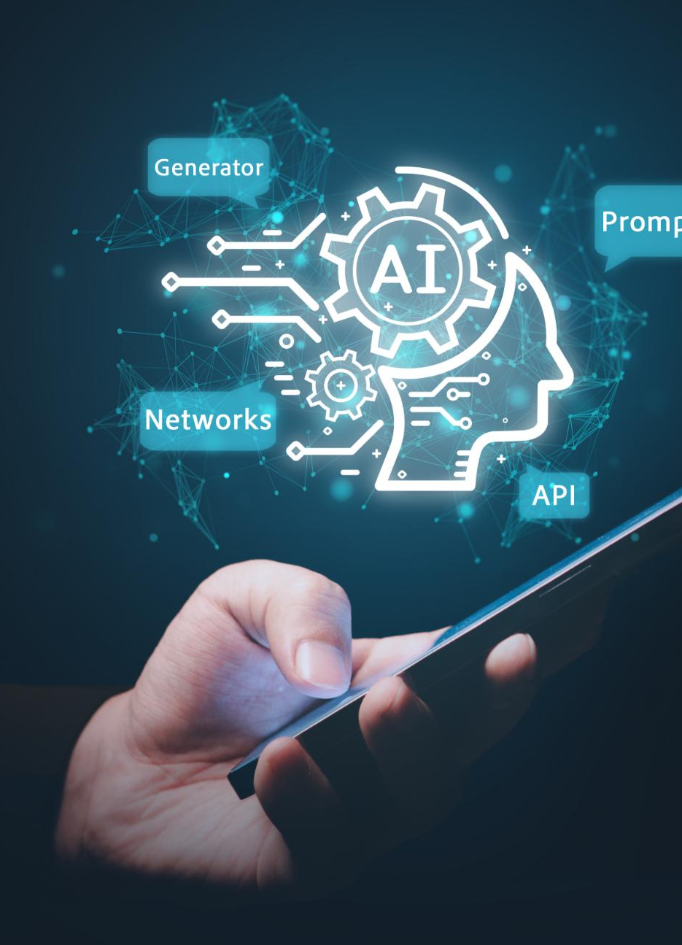
Unique Factory Approach
Plug-and-Play Solutions
  Seamlessly integrate with client operations
Proprietary Technology and AI Tools
  Maintain client data sovereignty
'Act as If' Principle
  Teams fully immerse in client operations
Immediate Impact
  Utilize battle-tested frameworks and methodologies
Notes:
We focus on creating plug-and-play solutions that integrate seamlessly with client operations. Our proprietary technology and AI tools ensure data sovereignty. By implementing our 'Act as If' principle, our teams fully immerse in client operations, delivering immediate impact through proven frameworks.
Original Content:
Creating plug-and-play solutions that seamlessly integrate with client operations.
Leveraging proprietary technology and AI tools while maintaining client data sovereignty
Implementing our "Act as If" principle, where our teams fully immerse themselves in client operations.
Delivering immediate impact through battle-tested frameworks and methodologies

Slide 11
Conclusion

